Slide 1
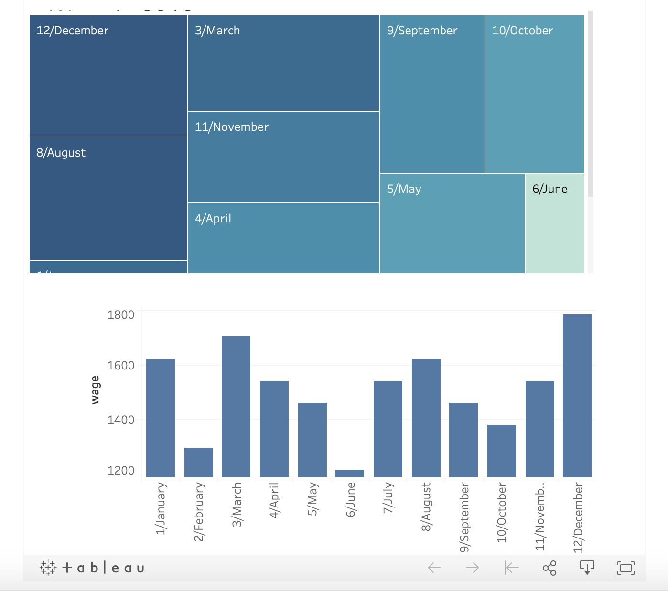
Wage in 2019
<visualization>
Tableau Public (go to https://public.tableau.com/s/ to install ) is used in this analysis. It’s the free version and can read data from CSV and Excel files which are used here. The created Tableau interactive dashboard is saved to a public workbook and can be downloaded from there. The link:
https://public.tableau.com/views/Wagein2019/Wagein2019?:embed=y&:display_count=yes&publish=yes&:origin=viz_share_link

Slide 2
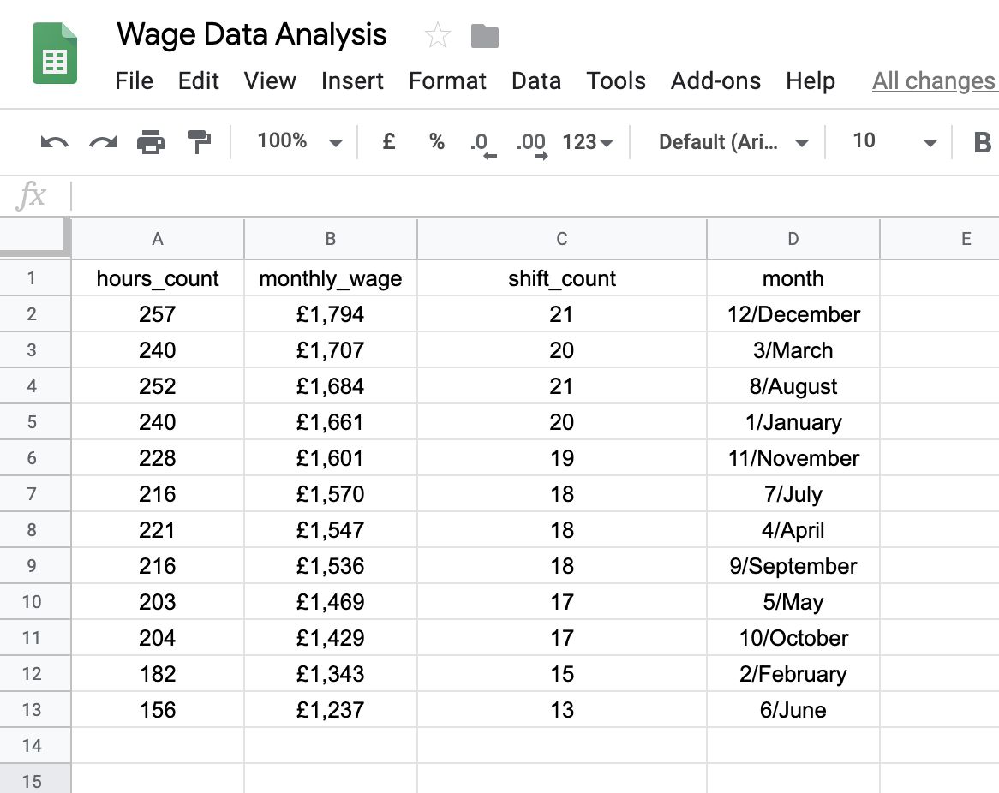
Summary Statistics
<visualization>
MAX net pay = £1,794
MIN net pay = £1,237
SUM net pay = £18,579
AVERAGE net pay = £1,536

Slide 3
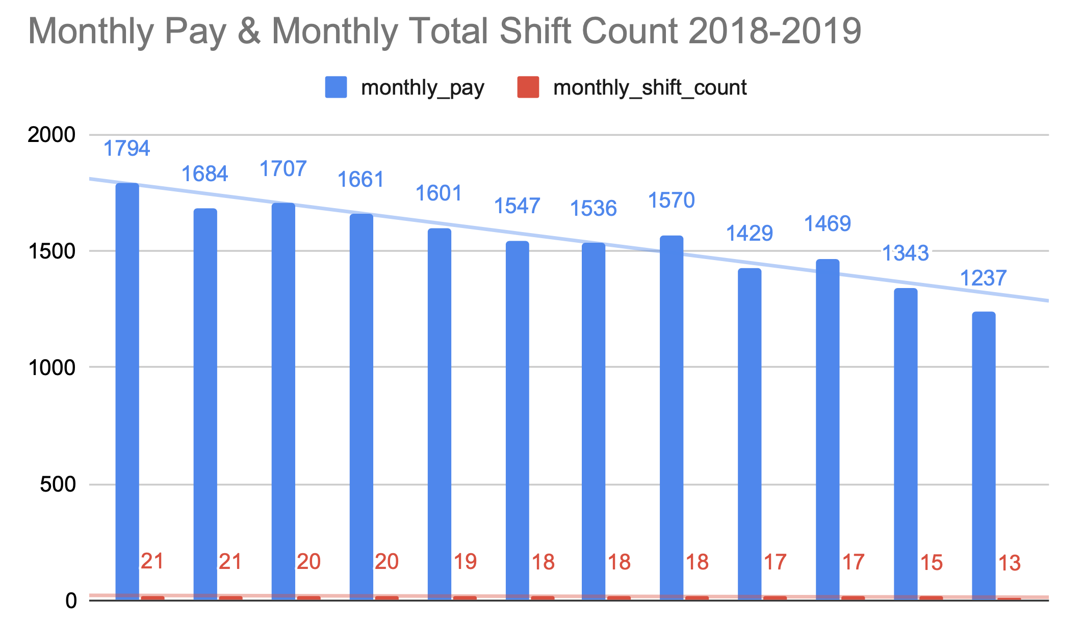
Summary Statistics
<visualization>
MAX shift_count = 21
MIN shift_count = 13
AVERAGE shift_count = 18
AVERAGE monthly_hours_count = 218

Slide 4
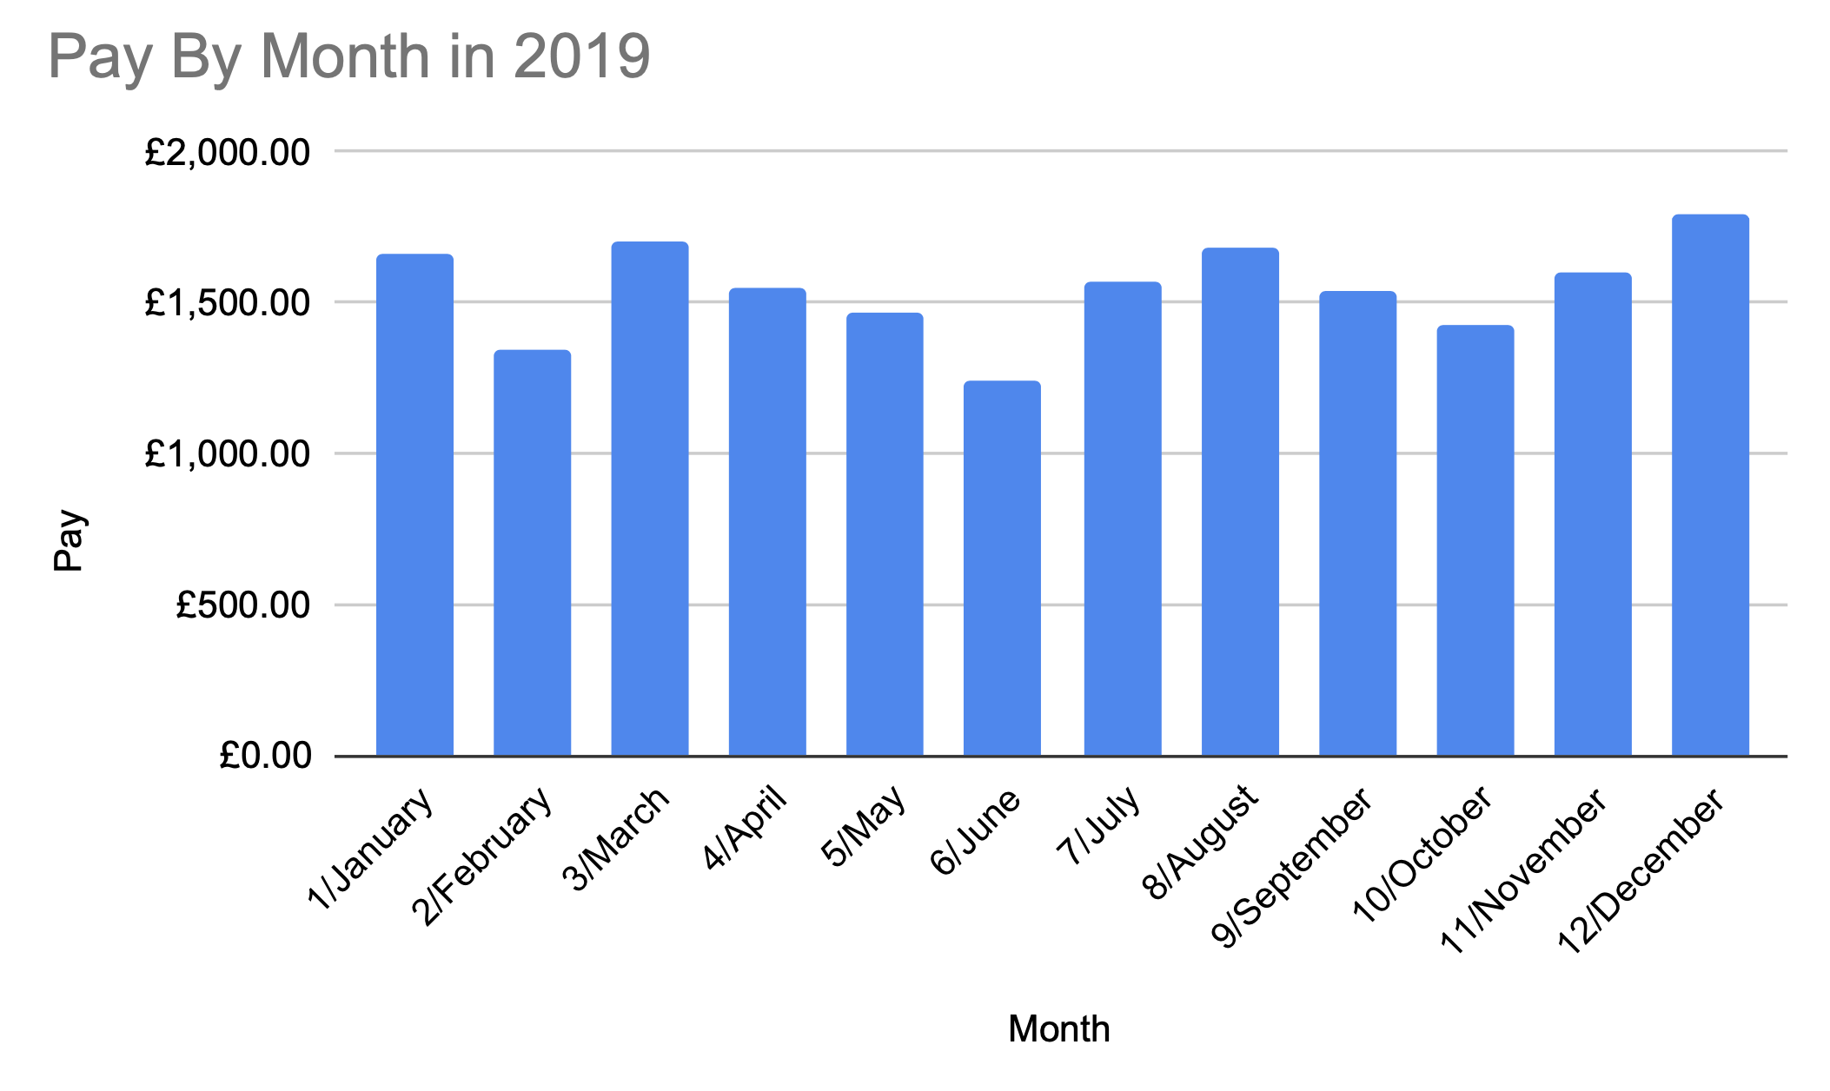
Wage in 2019

Slide 5
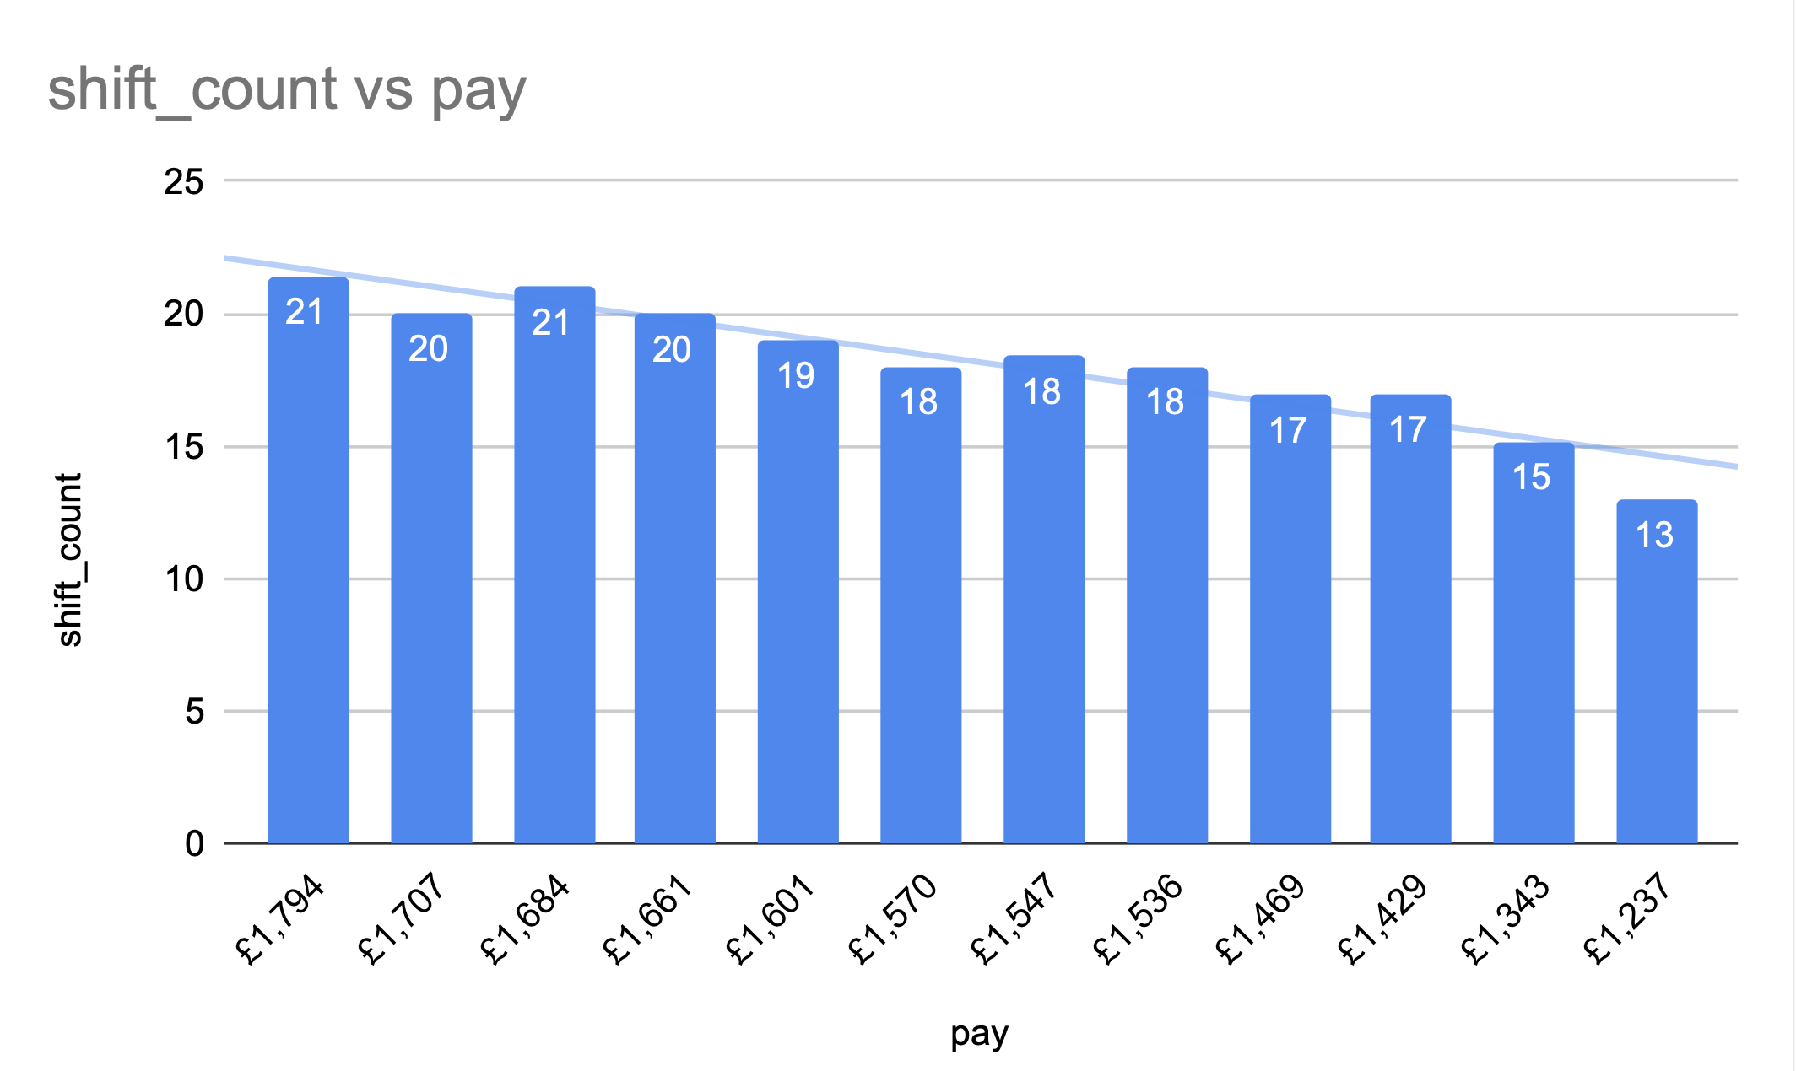
Wage in 2019

Slide 6
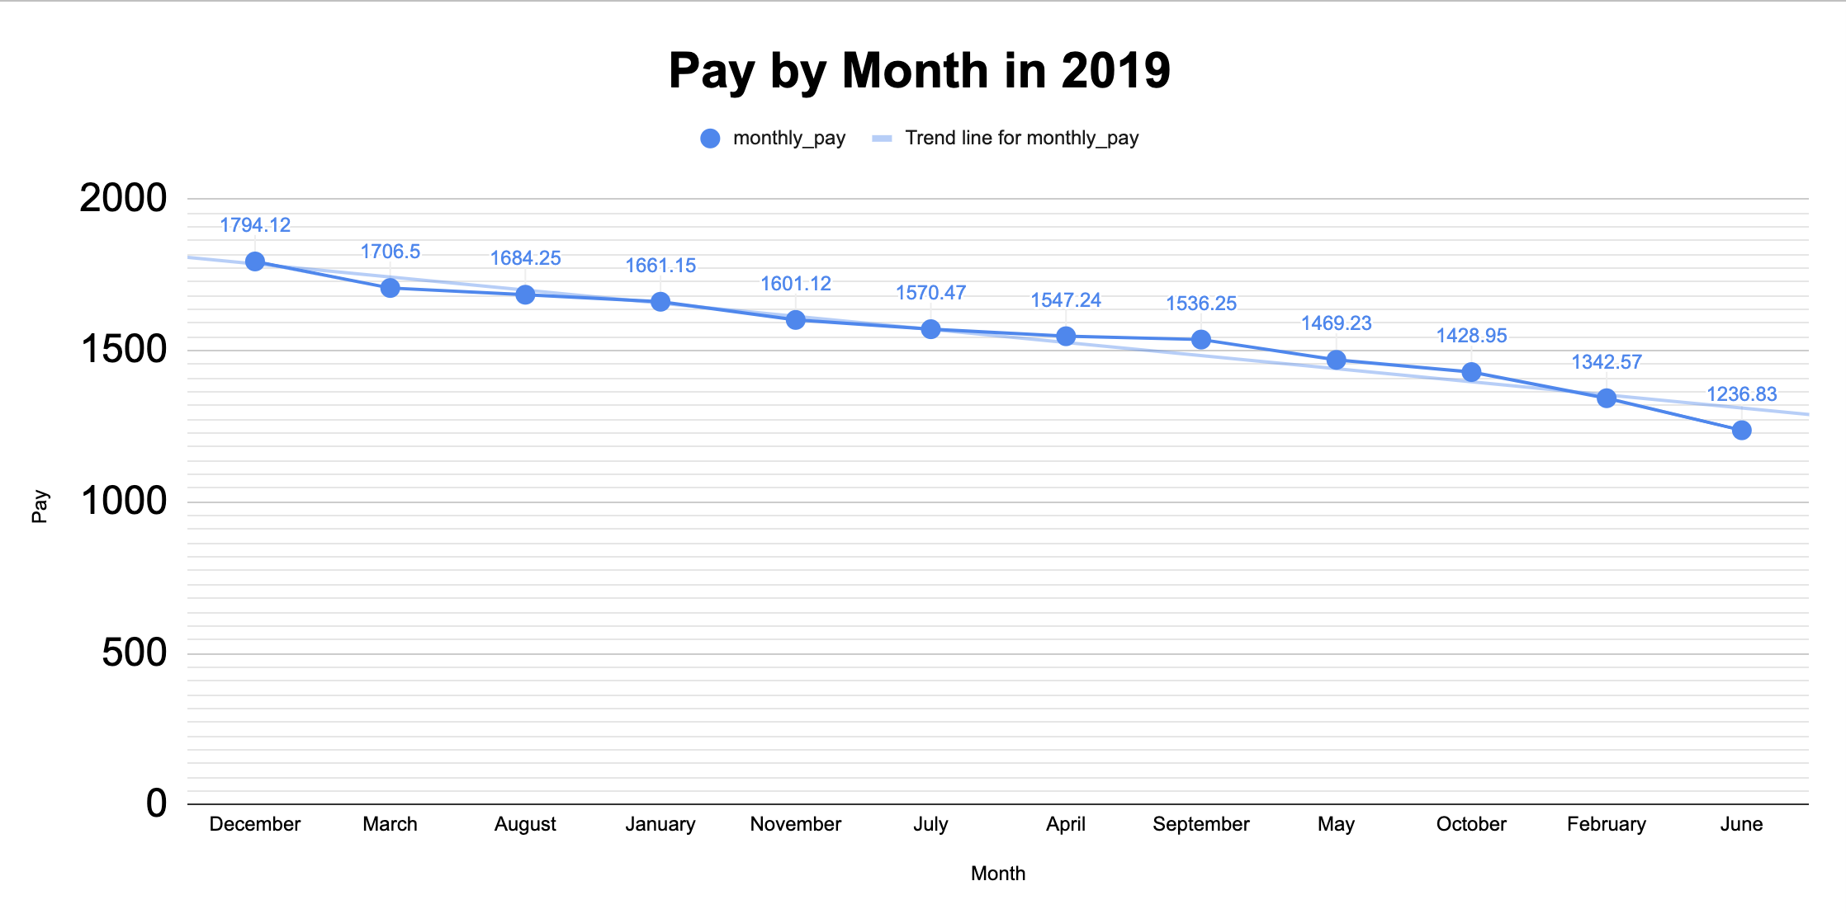
Wage in 2019

